Slide 1
Integration of Large Language Model-based Agents into Machine Learning Operations Pipeline
Name: Bozhen Zhu
Study Program: Computer Science (Master)
Matr.-No.: 437997
Supervisor(s): Prof. Dr. Stefan Decker
Advisor(s): Yongli Mou, M.Sc.

Slide 2
Introduction
Outline of Introduction
Overview of Large Language Models (LLMs)
Machine Learning Operations (MLOps)
Potential of LLMs in MLOps
Motivation
Research Question

Slide 3
Introduction
Overview of Large Language Models (LLMs)
LLMs have demonstrated remarkable capabilities in natural language processing tasks and beyond
The success of LLMs has led to a large influx of research contributions in diverse topics
architectural innovation
training strategies
context length improvements
fine-tuning
...
LLM evolves rapidly, such that it is approaching human capabilities in many ways

Slide 4
Introduction
Overview of Machine Learning Operations (MLOps)
MLOps is about the entire lifecycle from model development to deployment and management. It introduced DevOps concept in Machine Learning.
The goal of MLOps is to make the development and operation of machine learning projects more efficient, predictable, and repeatable.
Unlike Jupyter Notebook, it’s not about to show running history, the point is about to make experiments reproducible

Slide 5
Introduction
Potential of LLMs in MLOps
LLMs as Intelligent Agents:
Agent: Replicating and enhancing human workflows
LLM-based agents, using universal natural language as an interface, can perform as assistants to applications in coding, analyzing, and some other tasks in Machine Learning & DevOps domains
In real world, we work in teams
Existing implementation: The agent driven by LLM can write simple ML codes or DevOps codes
Simply chaining the agents (decomposing the tasks) will lead to hallucination

Slide 6
Introduction
Motivation and Research Question
How can an agent be designed so that he can solve more complex and integrative tasks in MLOps?
What sort of multi-agent system would ensure a successful collaboration amongst agents?
Is it possible to simulate a scenario in which humans play parts of the role in the whole MLOps pipeline, and the rest played by agents. Are the Agents robust enough in this scenario to cooperate in completing a entire project?

Slide 7
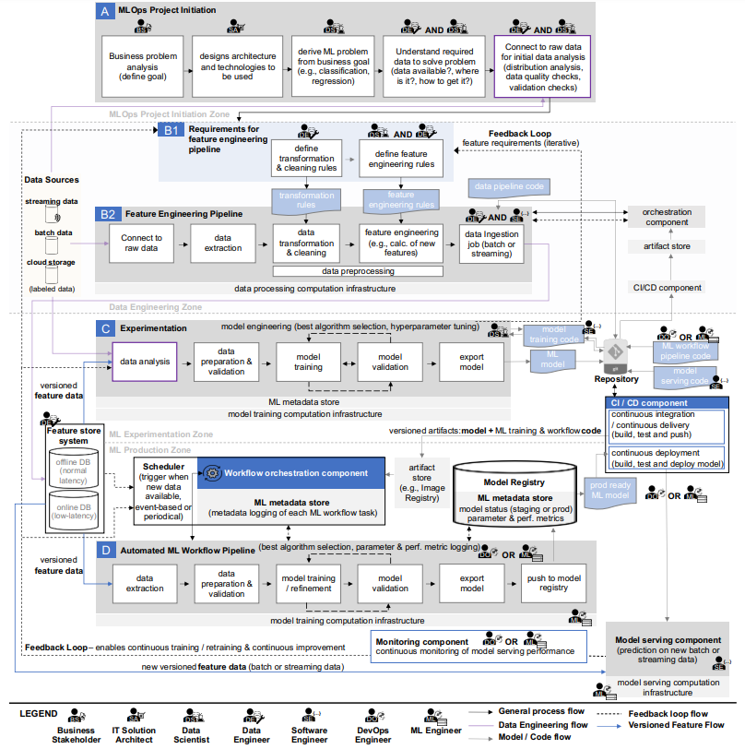
Literature Review
Complexity of MLOps
Machine Learning Operations (MLOps):
Overview, Definition, and Architecture
We can categorize tasks as follows
Version controls
Artifact controls
Experiments
Feature engineering
CI/CD
Deployments

Slide 8
Literature Review
Complexity of MLOps
We can see there are 7 roles defined in total, which implies that we might need 7 agents
However, there are some roles that involved in different zones/pipelines, which means they have to determine progress to date, identify the task at hand, and build on what others have developed.

Slide 9
Literature Review
Use of LLMs in AI agents
The Rise and Potential of Large Language Model Based Agents: A Survey
Exploring Large Language Model based Intelligent Agents: Definitions, Methods, and Prospects
These two articles demonstrate that LLM already has the ability to generate human indistinguishable results based on input
Chain-of-Thought Prompting Elicits Reasoning in Large Language Models
ReAct: Synergizing Reasoning and Acting in Language Models
MetaGPT: Meta Programming for A Multi-Agent Collaborative Framework
These articles show that multi-agent systems perform better than single-agent when solving complex problems.

Slide 10
Literature Review
Use of LLMs in AI agents
It is proven reliable at the moment to use LLM as brain of agents
And we do not need fine-tuning to enpower agents, but just prompt engineering
By writing proper prompt, we can ask LLM to play an role correctly and limit the output format or the way it “thinks” without having to make any adjustments to the LLM itself.

Slide 11
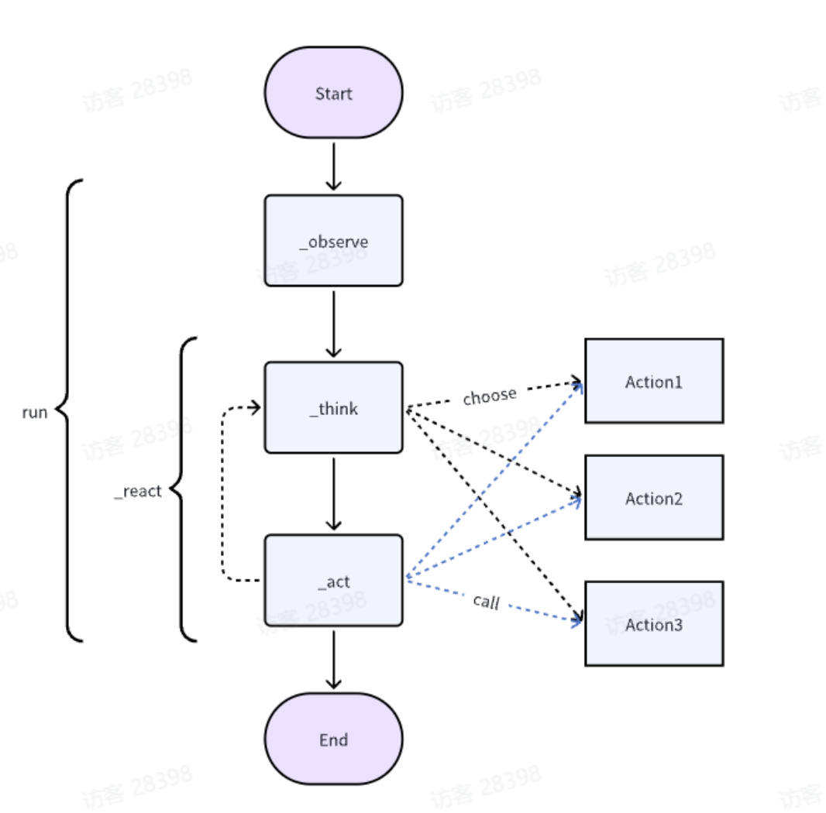
Literature Review
MetaGPT
MetaGPT has become one of the most popular project on GitHub
It introduced a multi-agent system framework
MetaGPT uses a ReAct strategy instead of Chain of Thoughts (CoT) to manage agents
Think & Reflect
Observe
Broadcast messages
Knowledge precipitation & Act
State management

Slide 12
Research methodology
Develop of Single Agent
Take Data Scientist defined in the MLOps as an example, we should write prompt such that this agent has at least the following capabilities in experiments pipelines:
Receive data, analyz it
Select the most suitable algorith
Training of the model
Export the model (both the code for model training and the instantiated model, e.g., the model's parameter values, etc.) and push it to a Git repository.

Slide 13
Research methodology
Develop of Single Agent
Take Data Scientist defined in the MLOps as an example, we should write prompt such that this agent has at least the following capabilities in experiments pipelines:
Receive data, analyz it
...
This requires at least:
Write prompts so that the agent can:
understand the upstream output format
perform tasks rationally
output in desired format
And write codes in python so that agent can
translate the upstream output to LLM understanble plain text
transform the plain text generated by LLM to e.g. runnable code
record results
...

Slide 14
Research methodology
Develop of Multi-Agent System
Manage the agents in MetaGPT defined system
Define the enviorment and actions
Further develop of each agent, align it to perform correctly in the system
Enable agents to listen/respond to specific actions and publish its results to the enviorments
Allow human to play some roles instead of agents such that we can perform a ablation study

Slide 15
Expected Results
Gain a comprehensive understanding of the possibility to integrate LLM into machine learning operations pipelines
Derive the difference in capabilities between single-agent and multi-agent systems
Derive the robustness of MetaGPT defined ReAct framework

Slide 16
Expected Results
Evaluation Indicator
Pass@k:
We evaluate whether in generated k versions is there any one could pass the unit-tests previously defined, which ask the system having key abilities:
Implement a artifacts stores
Implement code version controls
Respond to new data available
Deploy the model
Rounds n:
The agent is allowed to incrementally develop. We will test in how many rounds in average can an agent deliver the runable code.

Slide 17
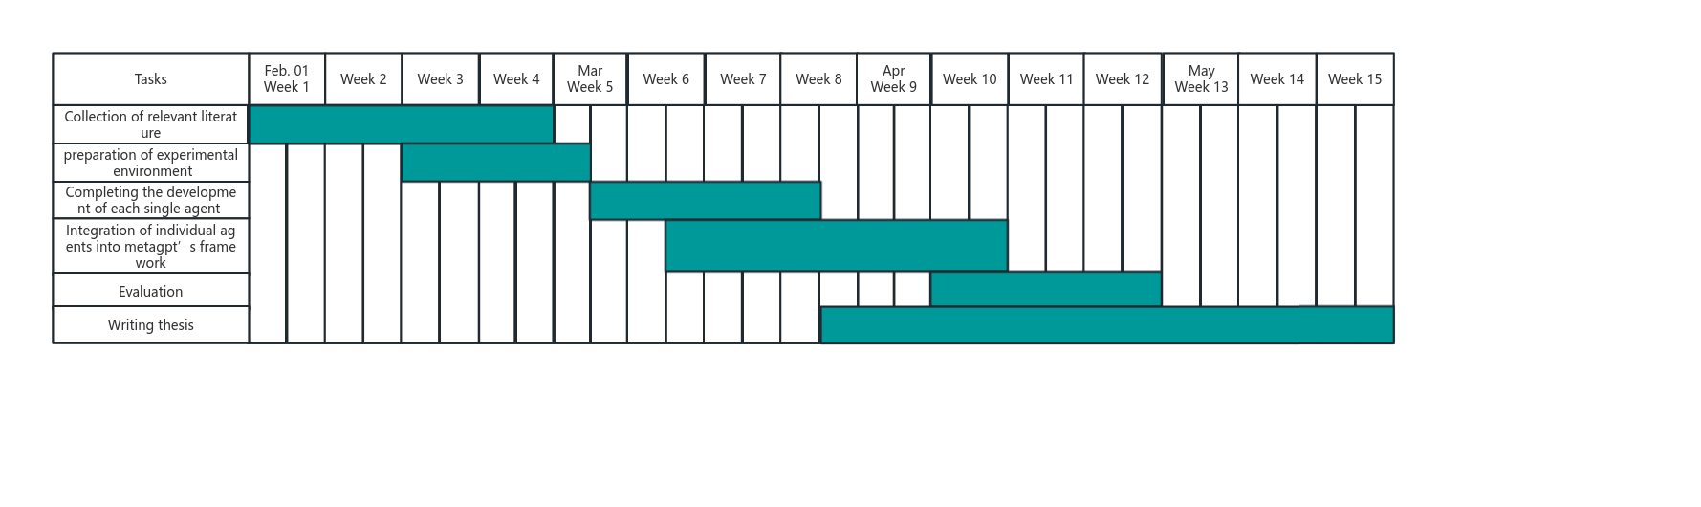
Timetable

Slide 18
Reference List
The Rise and Potential of Large Language Model Based Agents: A Survey
Machine Learning Operations (MLOps): Overview, Definition, and Architecture
A Comprehensive Overview of Large Language Models
Exploring Large Language Model based Intelligent Agents: Definitions, Methods, and Prospects
Chain-of-Thought Prompting Elicits Reasoning in Large Language Models
ReAct: Synergizing Reasoning and Acting in Language Models
MetaGPT: Meta Programming for A Multi-Agent Collaborative Framework
Improving Large Language Model Fine-tuning for Solving Math Problems
Unleashing the potential of prompt engineering in Large Language Models: a comprehensive review
Prompt Engineering or Fine Tuning: An Empirical Assessment of Large Language Models in Automated Software Engineering Tasks

